Slide 1
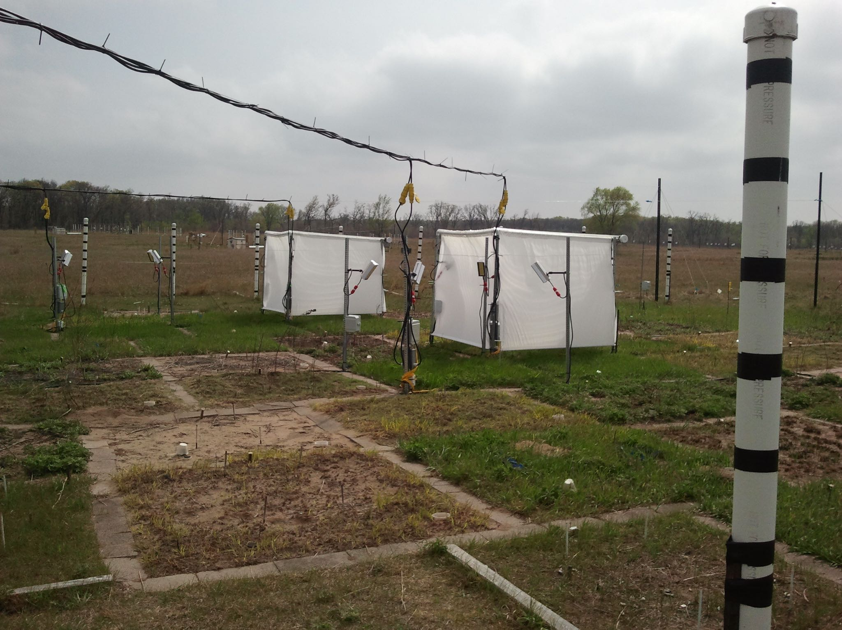
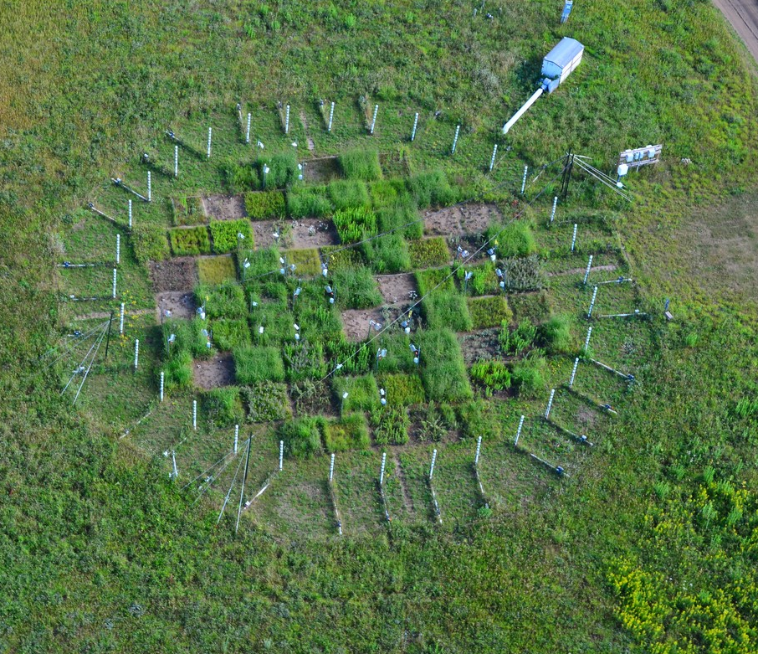
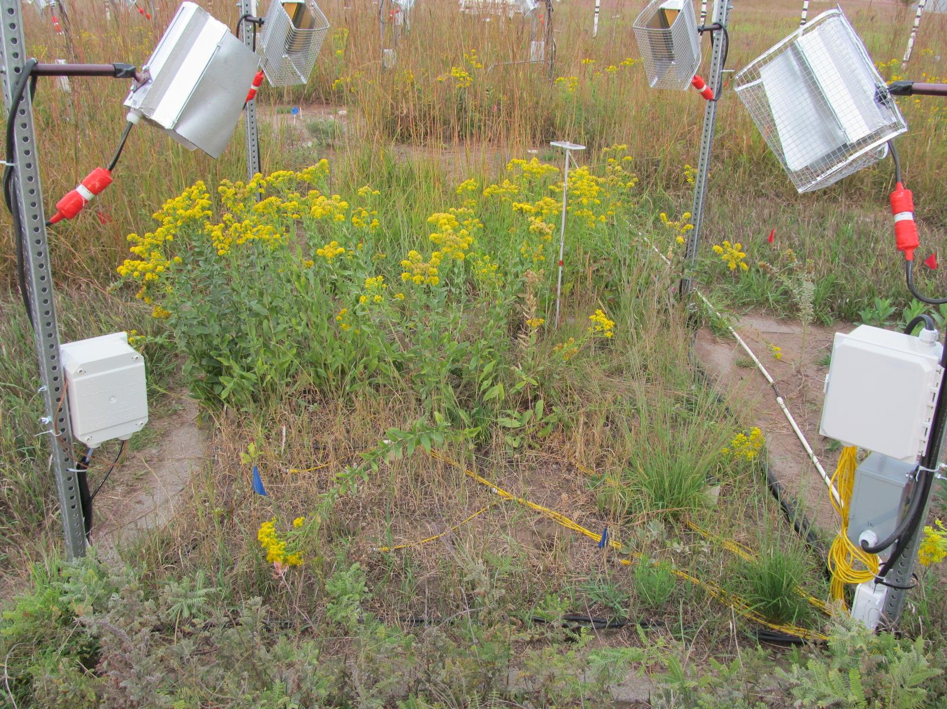
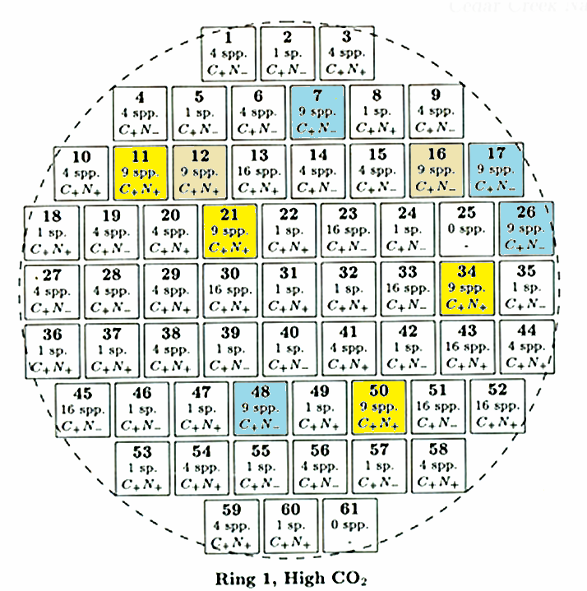
TeRaCON- Temperature-Rainfall-CO₂ –Nitrogen P Reich (PI), S Hobbie, many others
Perennial grassland (Minnesota, USA)
Began 2012 (subset of BioCON, began 1998)
9 species randomly chosen from pool of 16 plant species from 4 functional groups
48 2 x 2 m plots; 2 x 2 x 2 x 2 factorial
Ambient & warmed 2.5C
Ambient & reduced summer rain
Ambient & elevated CO2
Ambient & enriched N
Event based rainfall exclusion
Free-Air CO₂ Enrichment (+ 180 ppm)
N addition (4 g N m⁻² y⁻¹)
-40% rain
+2.5°C
Infrared Heat + Resistance Pin Heat in Soil to 1m deep

Slide 2
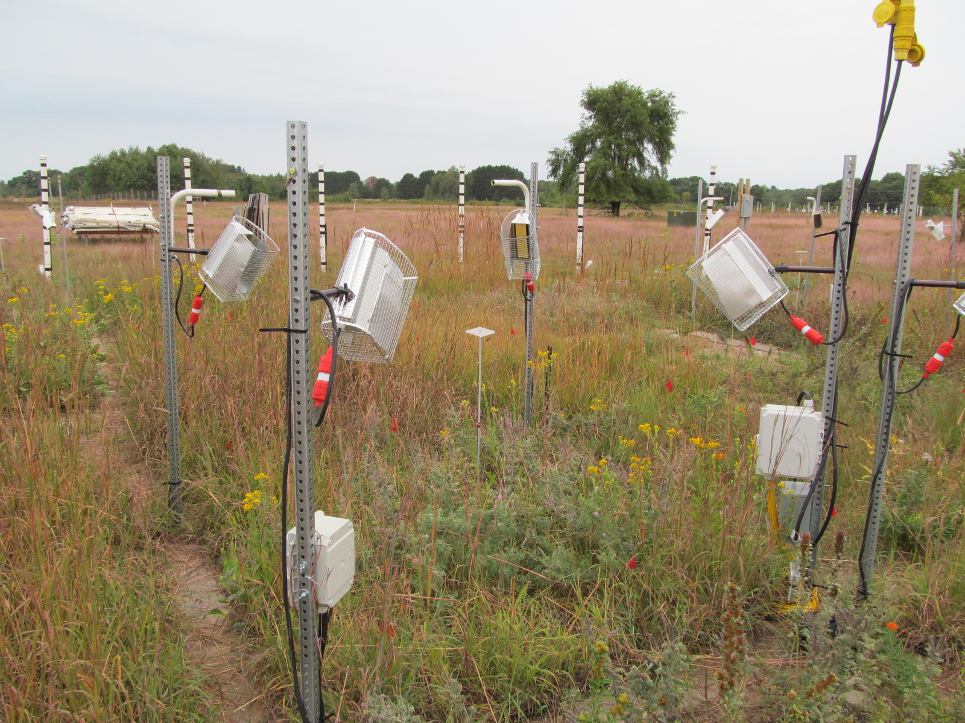
Wind

Slide 3
Data list from most frequent to least [what is missing?]
Continuous temperature and soil moisture
10-13x each year soil CO2 flux
10-13x each year light interception
Annual aboveground & belowground plant biomass (by depth)
Annual aboveground & belowground plant %C, %N
Annual in-growth root production
Annual one-month in situ net N mineralization (and soil solution N)
Annual species composition, richness, abundance (clip strips, % cover area)
Campaign-based trait data [Liting]
Campaign-based spectral data [Forest]
Campaign-based plant ecophys data [Sarah R]
Campaign-based reproductive data [?]
Soil C and N (every 5 years, by depth)
Soil microbiome campaigns [J Zhou group, OK]
Campaign-based (2019) spatial patterns [324 10 x 10 cm cells/plot] plant cover & composition [Z Wang]

Slide 4
Publications have been too sparse!
Pastore MA, TD Lee, SE Hobbie, PB Reich. 2020. Interactive effects of elevated CO2, warming, reduced rainfall, and nitrogen on leaf gas exchange in five perennial grassland species. Plant Cell Environ 43:1862-1878
Reich PB, SE Hobbie, TD Lee, R Rich, MA Pastore, K Worm. 2020. Synergistic effects of four climate change drivers on terrestrial carbon cycling. Nature Geoscience 13, 787–793
Thakur MP, I Martín Del Real, S Cesarz, K Steinauer, PB Reich, S Hobbie, M Ciobanu, R Rich, K Worm, N Eisenhauer. 2019. Soil microbial, nematode, and enzymatic responses to elevated CO₂, N fertilization, warming, and reduced precipitation. Soil Biology and Biochemistry 135: 184-193
Carey, JC, J Tang, PH Templer, et al. 2016. Temperature response of soil respiration largely unaltered with experimental warming. Proceedings of the National Academy of Sciences 113 13797-13802 www.pnas.org/cgi/doi/10.1073/pnas.1605365113
Reich, PB, SE Hobbie, TD Lee. 2014. Plant growth enhancement by elevated CO₂ eliminated by joint water and nitrogen limitation. Nature Geoscience 7:920–924, doi:10.1038/ngeo2284

Slide 5
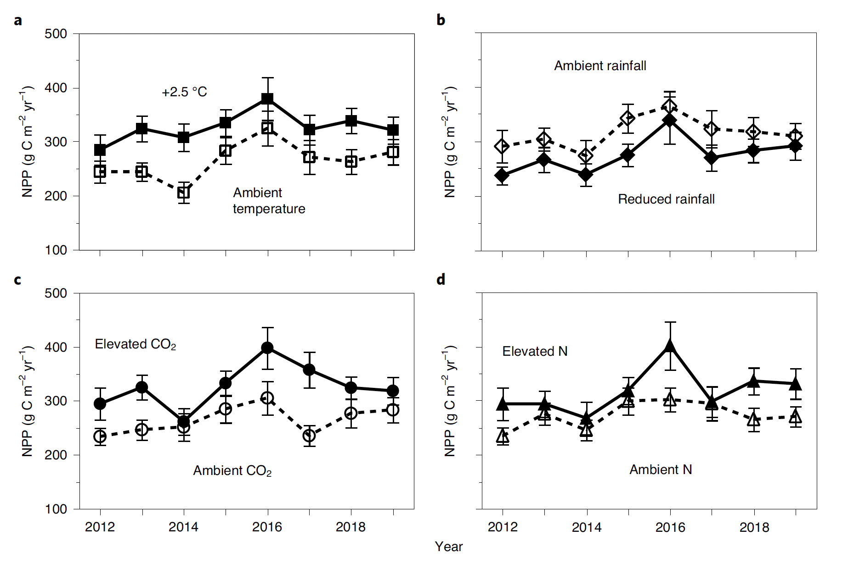
Interactive effects of global change drivers on carbon cycling processes, including soil C
Global changes all influence NPP (ANPP+BNPP)
Now we have data through 2024
Reich et al 2020 Nature Geoscience

Slide 6
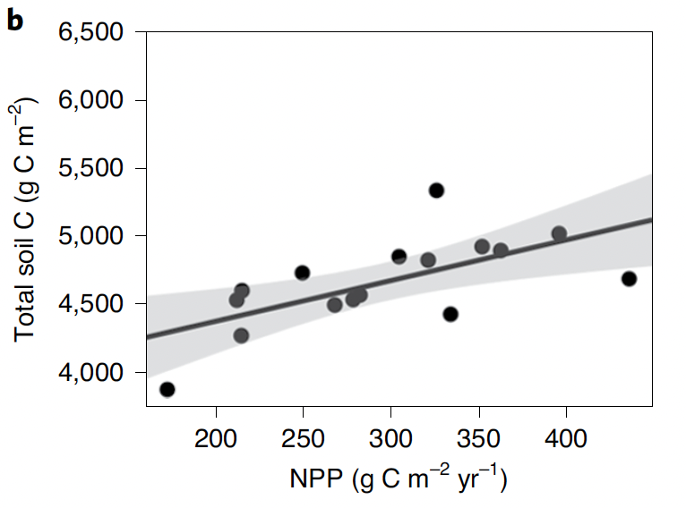
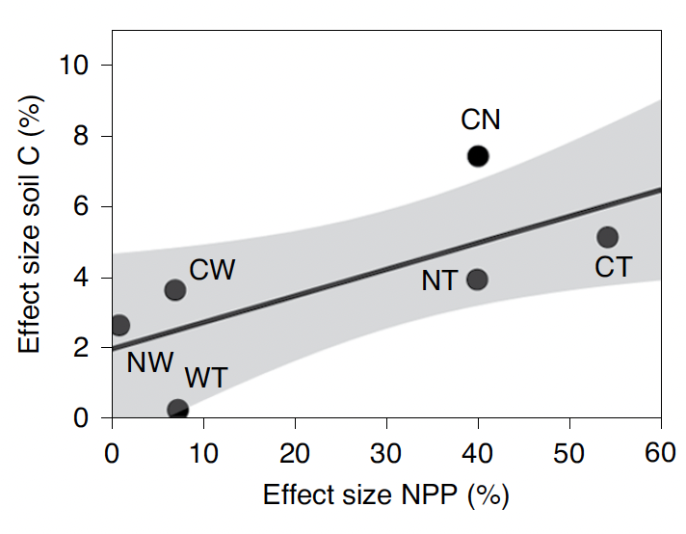
Interactive effects of global change drivers on carbon cycling processes, including soil C
Inputs over 5 years drove soil C (2016)
Global changes that increased NPP also increased soil C
Now we have soil C data for 2022 (at four depths)
Reich et al 2020 Nature Geoscience

Slide 7
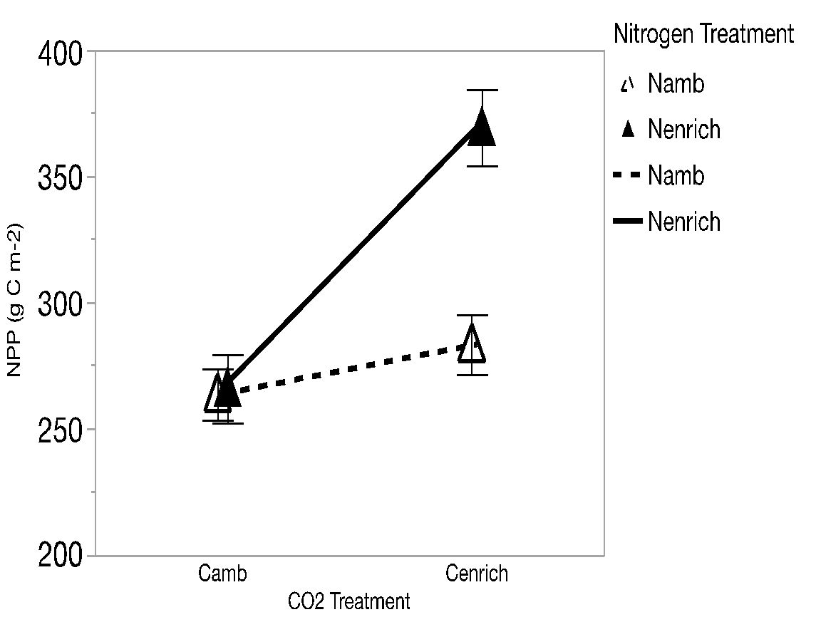
Example Hypotheses
Multiple limitation theory:
growth response to any limiting factor lower when other resources limiting or co-limiting (synergistic)
Ecosystem function
Enriched N
Ambient N
Ambient
CO₂
Elevated
CO₂

Slide 8
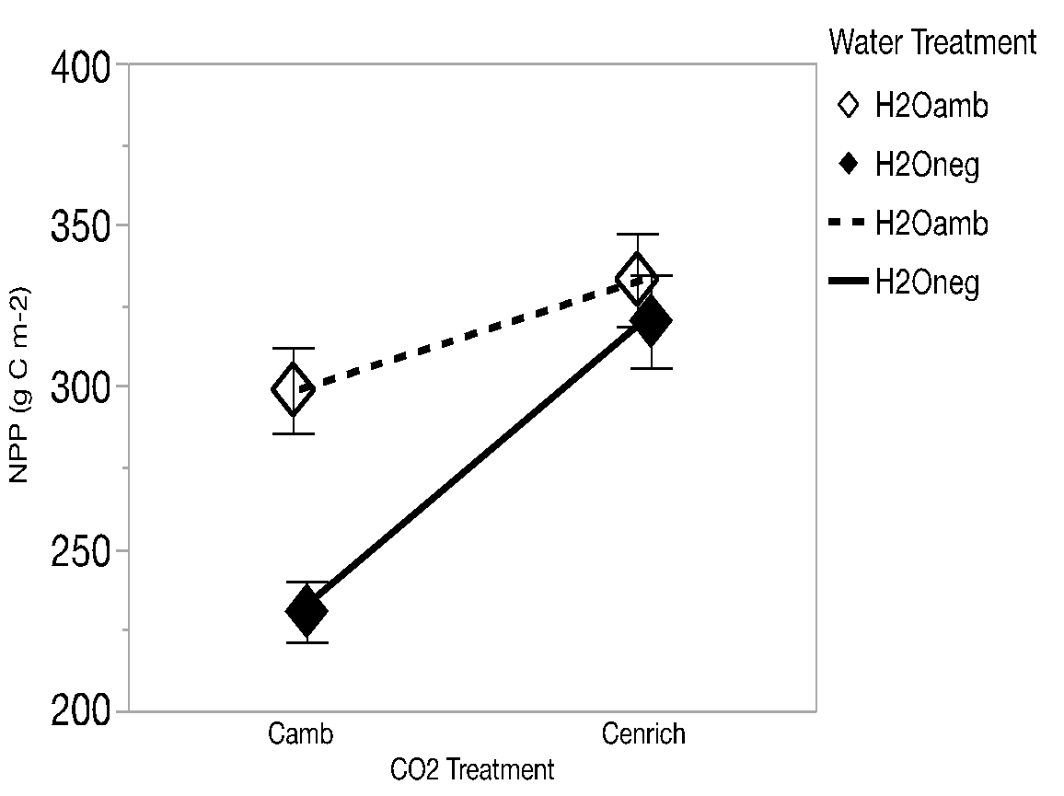
Example Hypotheses
CO₂-induced water-savings hypothesis:
Reduced rainfall will have less negative effects when CO₂ is elevated (antagonistic)
Ambient rainfall
Ecosystem function
Reduced rainfall
Ambient
CO₂
Elevated
CO₂

Slide 9
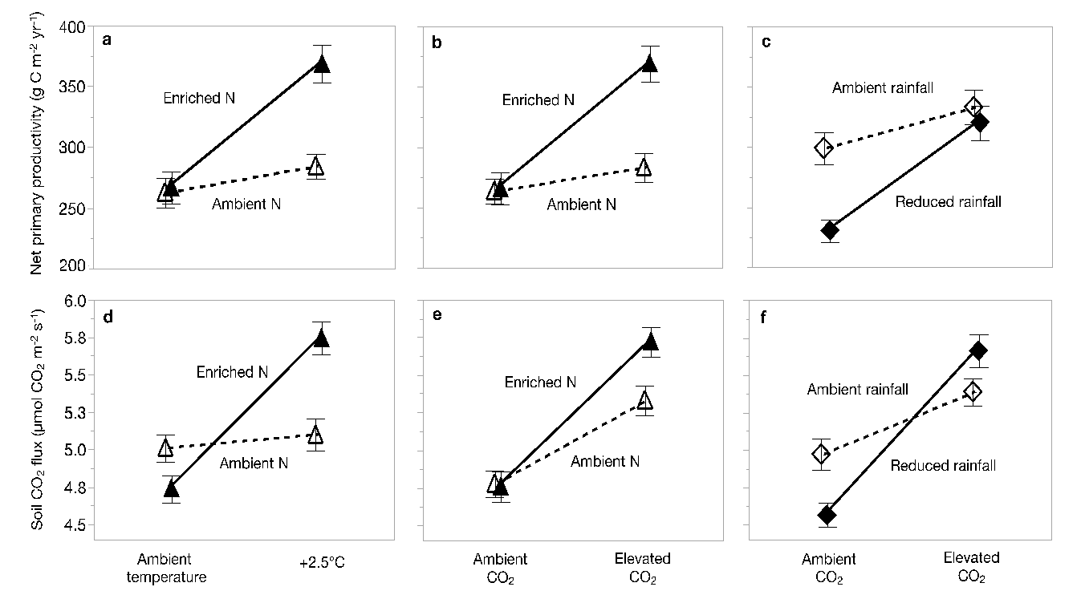
Wind
Synergistic interactions
Synergistic interactions
Antagonistic interactions
Reich et al 2020 Nature Geoscience

Slide 10
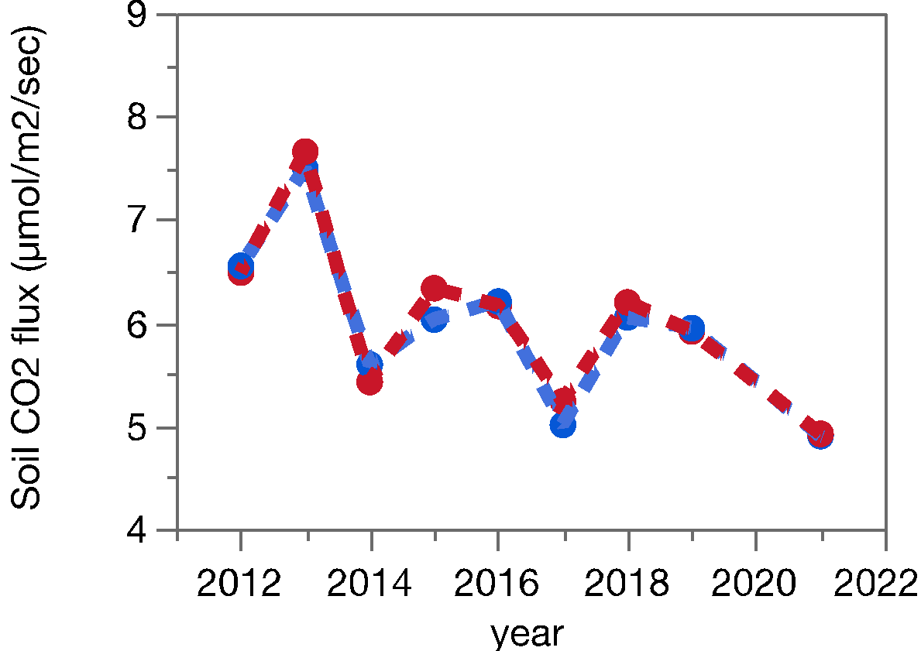
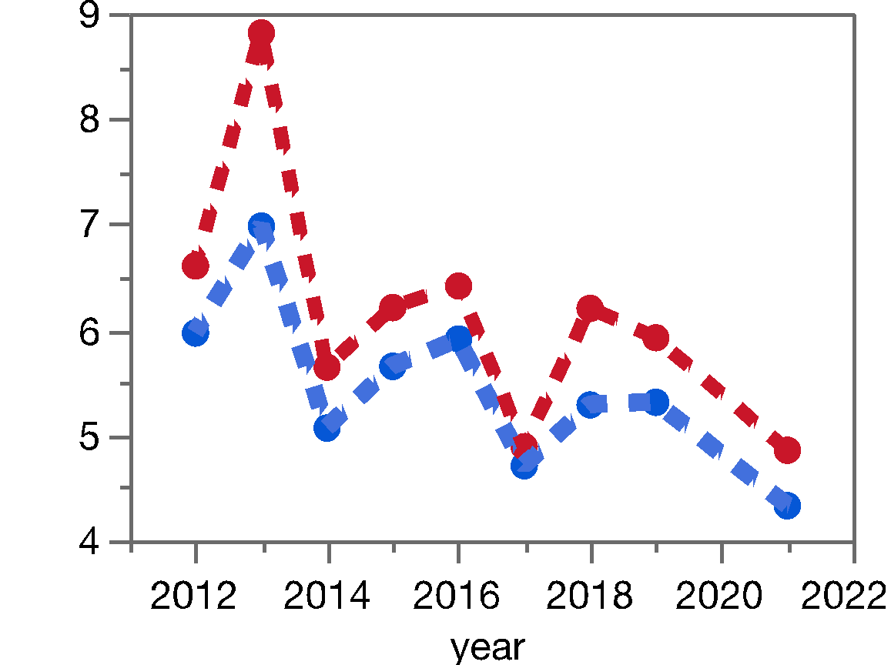
Interactive effects of global change drivers on carbon cycling processes, including soil C
Lots of interactions: for example, soil CO₂ flux increased by warming but only in low rainfall treatment
Ambient summer rainfall
40% reduced summer rainfall
+2.5 C
+2.5 C
Ambient temperature
Ambient temperature
Unpublished data, TeRaCON team

Slide 11
Use BioCON papers as guide to worthwhile questions to address?
One example (Guopeng)
Mechanisms underlying effects of 26-year plant diversity, eCO₂, and N addition on soil C vary with soil depth and experimental duration

Slide 12
5th year
10th year
15th year
19th year
25th year
Bio
CO2
N
Bio
CO2
N
Bio
CO2
N
Bio
CO2
N
Bio
CO2
N
0 - 20 cm
AB
BB
AB
BB
AB
BB
AB
BB
AB
BB
SR
SR
SR
SR
SR
SOC
SOC
SOC
SOC
SOC
Bio
CO2
N
Bio
CO2
N
Bio
CO2
N
Bio
CO2
N
Bio
CO2
N
0 - 40 cm
AB
BB
AB
BB
AB
BB
AB
BB
AB
BB
SR
SR
SR
SR
SR
SOC
SOC
SOC
SOC
SOC
Bio
CO2
N
Bio
CO2
N
Bio
CO2
N
Bio
CO2
N
Bio
CO2
N
0 - 60 cm
AB
BB
AB
BB
AB
BB
AB
BB
AB
BB
SR
SR
SR
SR
SR
SOC
SOC
SOC
SOC
SOC
Notes:
Bio: species richness; CO2: elevated CO2; N: nitrogen addition; AB: aboveground biomass; BB: belowground biomass; SR: soil respiration. Blue, red, and gray colors represent positive, negative, and insignificant relationships, respectively, and the thickness of the arrow means the magnitude of the relationship.
In the short term (the 5th year), although biodiversity, elevated CO2, and nitrogen addition increase both above- and below-ground biomass, SOC is not ultimately increased because it takes a relatively long time for litterfall and roots to be decomposed and to become SOC;
In the mid-term (the 10th and 15th year), biodiversity, elevated CO2, and nitrogen addition start to stimulate SOC by increasing both above- and below-ground biomass; and the increased belowground biomass mainly contributes to the increased SOC;
In the long term (the 19th and 25th year), biodiversity, elevated CO2, and nitrogen addition keep stimulating SOC by increasing both above- and below-ground biomass; and the increased aboveground biomass mainly contributes to the increased SOC;
The contribution of belowground biomass to increased SOC decreases with soil depth.

Slide 13
Topics/Papers (all below are “impacts of 4 global change factors on…”)
Continuous temperature and soil moisture [Jeff]
Biomass and Productivity
Carbon allocation to roots (by depth) versus shoots
Root turnover [Peter?]
Soil C and N cycling (pools and fluxes) [Katie, Guopeng, Xinli]
Total belowground carbon allocation [Xinli, Katie, ?]
Complete C and N budgets [Mingkai, ?]
Modeling of C & N cycles [Lei, Bill]
Traits of individual species and of entire plots [Liting and ??]
Diversity and composition [Peter]
Stability across treatments and time [Qianna]
Linking traits, communities and ecosystem responses [??]
Ecological acclimation [Kara]
Modeling of plant community composition [????]
C3 vs C4 ecophys leaf to stand [Sarah R]
Spectral data [Forest]
Reproductive data [?]
Spatial patterns [324 cells per plot] plant cover & composition [?]
Soil microbiome [J Zhou group, OK & ??]
develop 3-6 working groups?

Slide 14
Examples of what some are already doing!

Slide 15
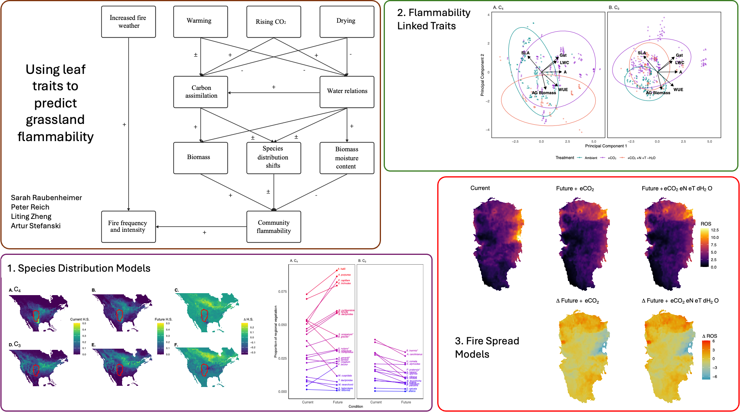

Slide 16
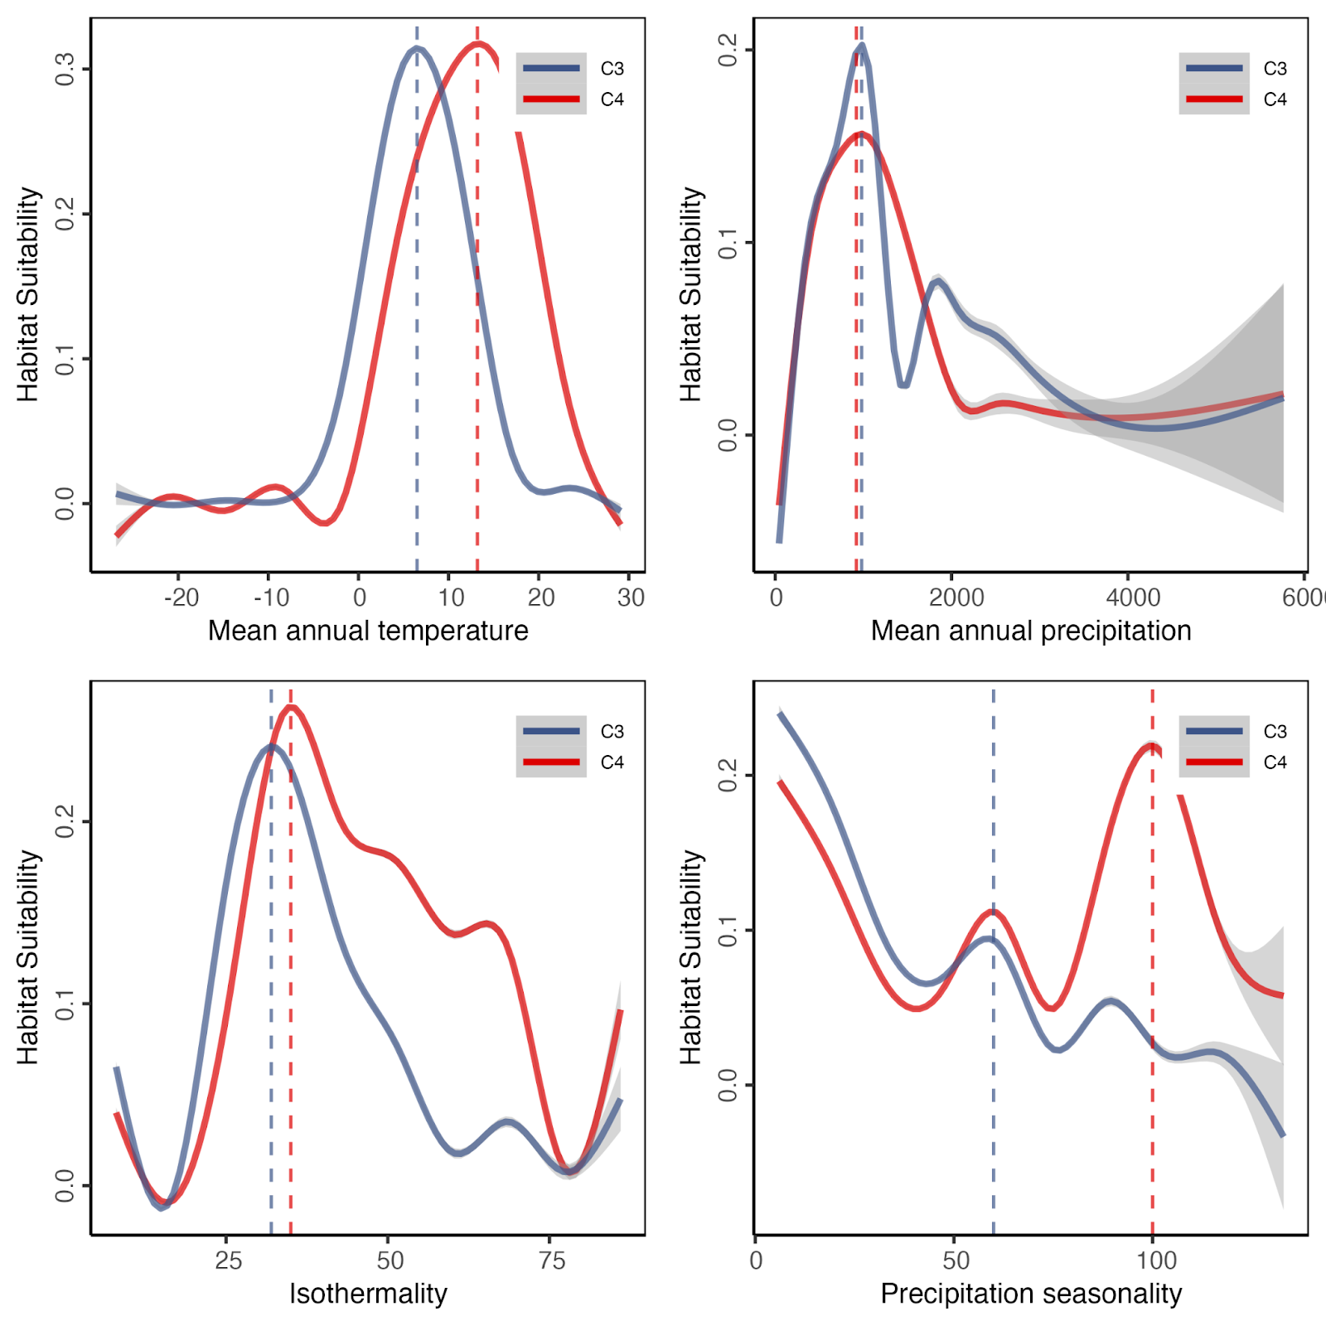
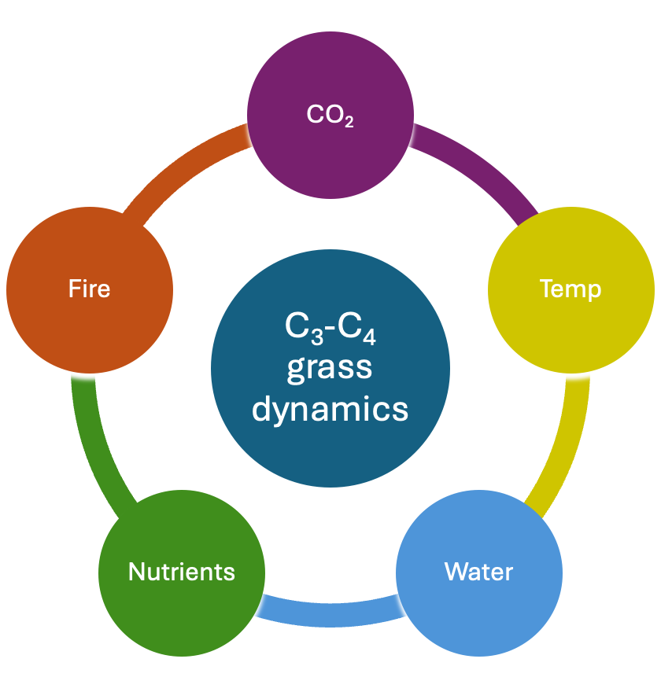
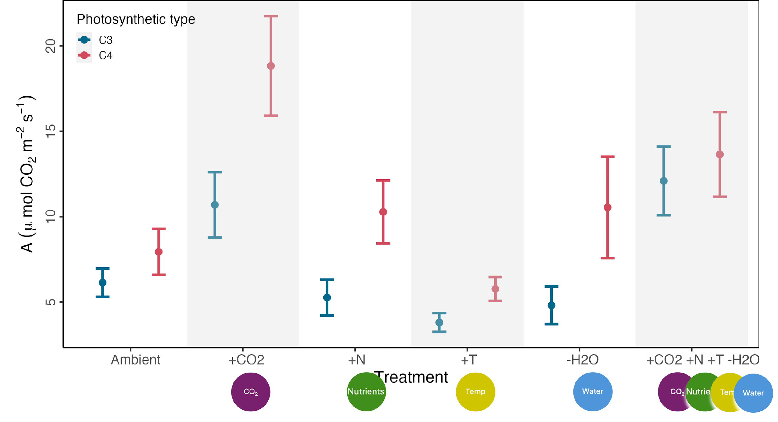
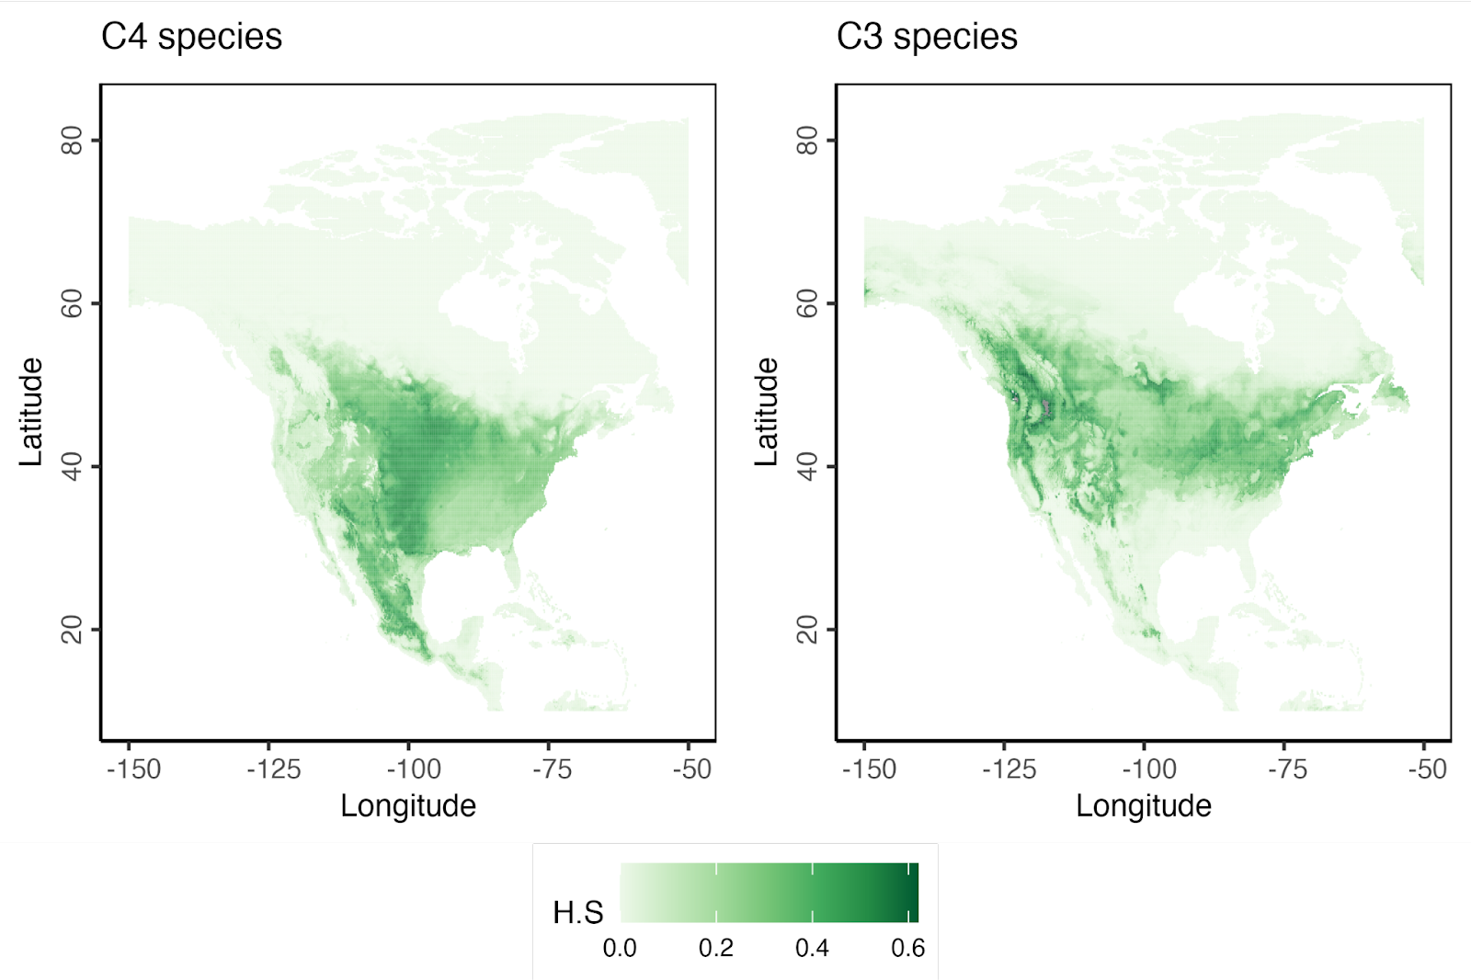
Mechanisms for the increasing success of C₄ grasses
2.Exploring drivers
Temp
Water
3. Responses in TeRaCON
Sarah Raubenheimer
Peter Reich
Artur Stefanski
1. Species Distribution Models
Temp
Water

Slide 17
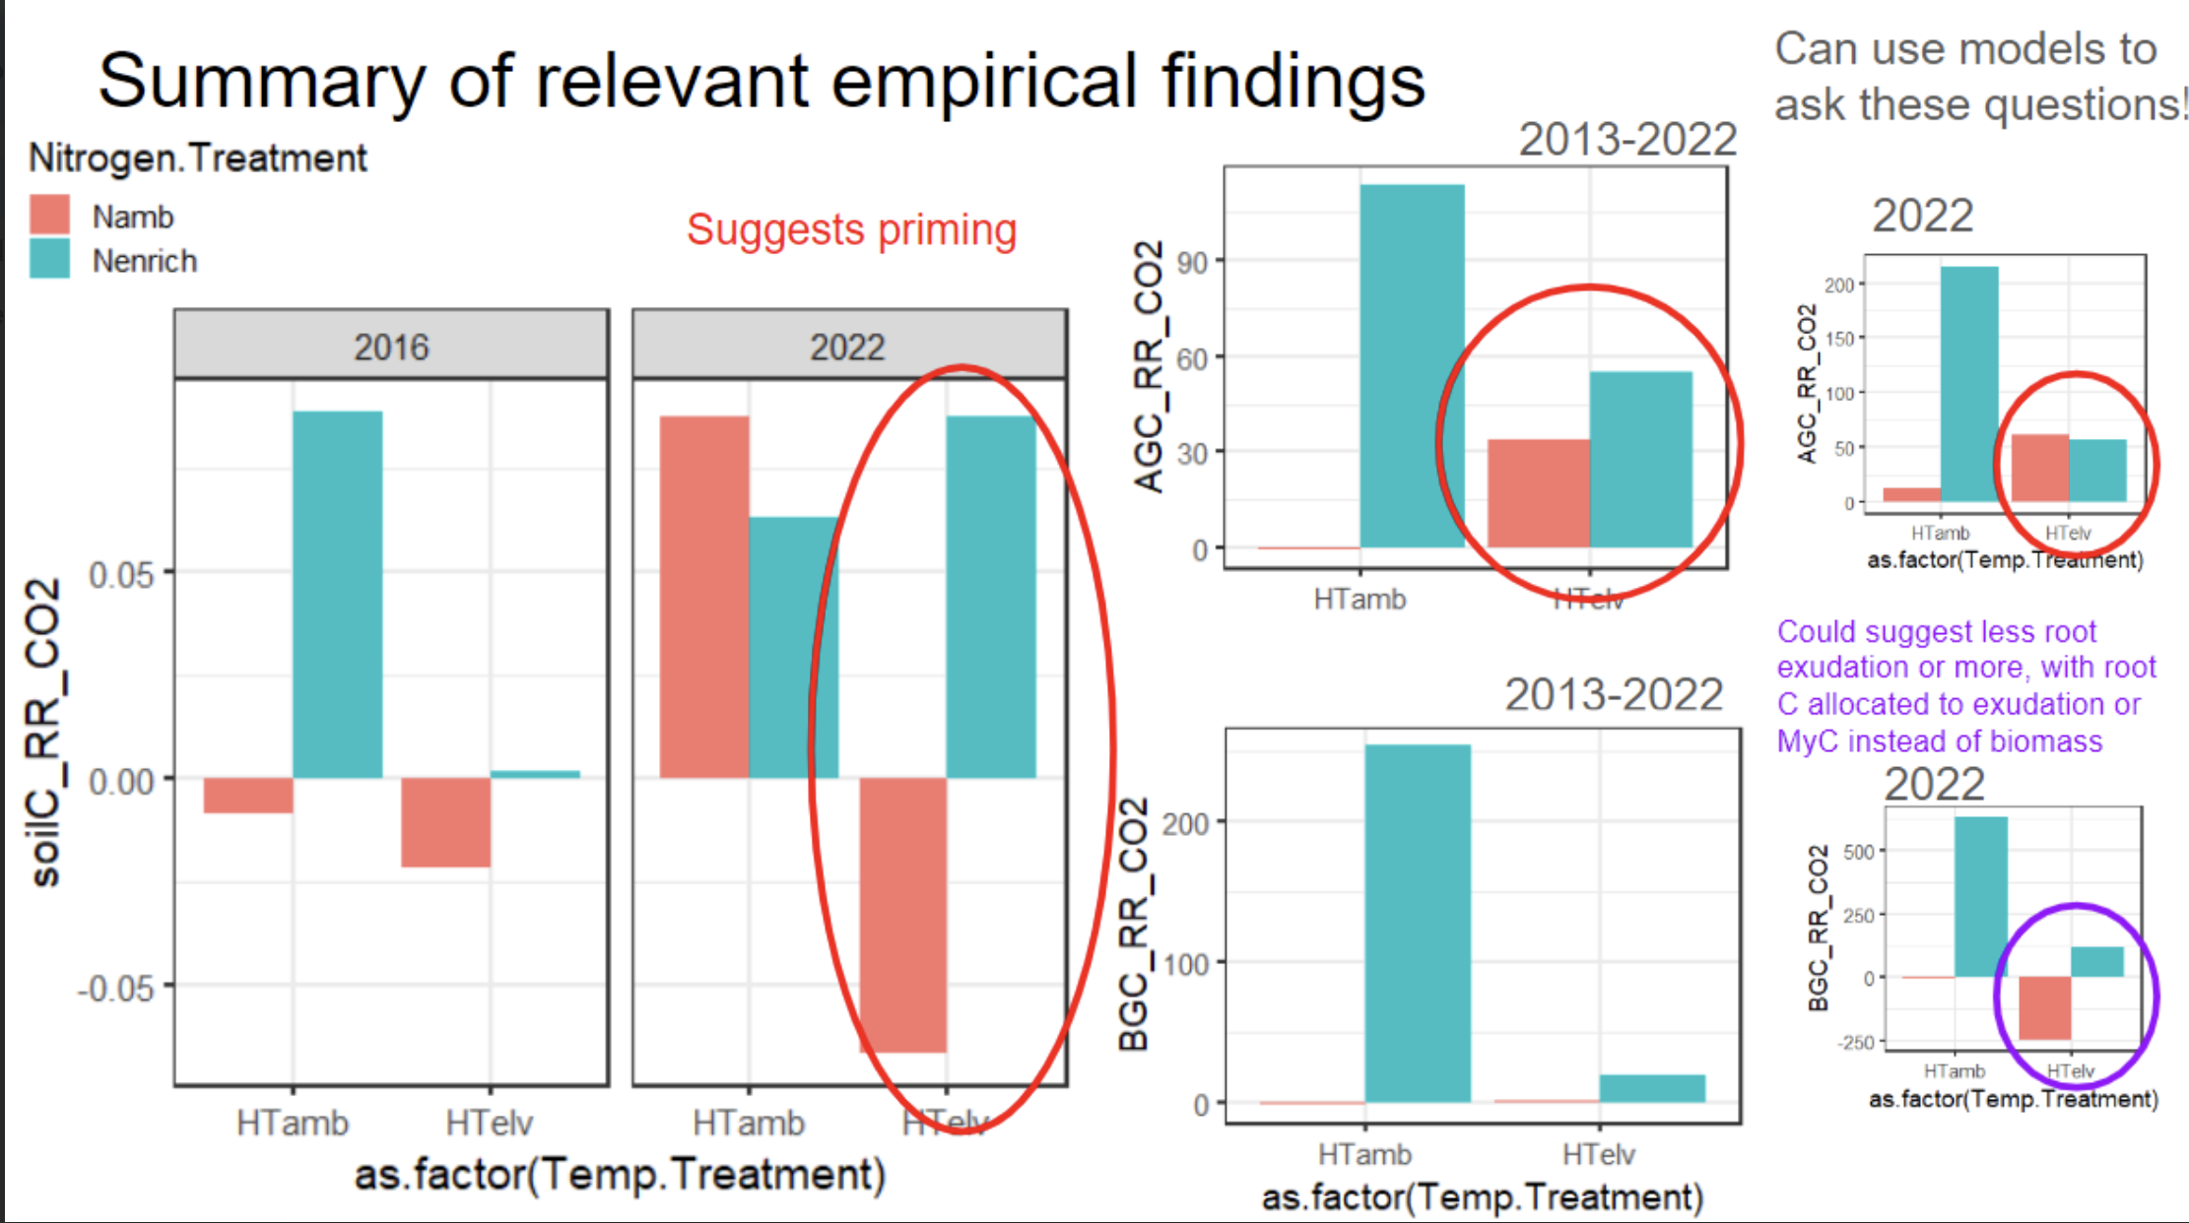
Soil biogeochemical responses to interactive global change with the Community Land Model (CLM)
Katie Rocci, Will Wieder, Peter Reich
Calibrate CLM with two different soil models for Cedar Creek
Evaluate how well these models reproduces soil biogeochemical responses to warming and elevated CO2
Use the models to test whether some plant-microbe-soil interaction hypotheses can explain the observed soil BGC responses, like priming or exudation.

Slide 18
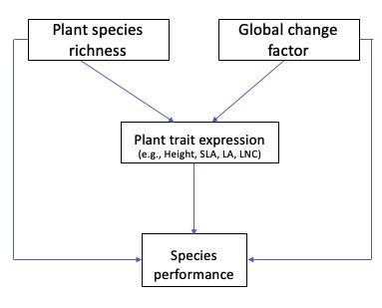
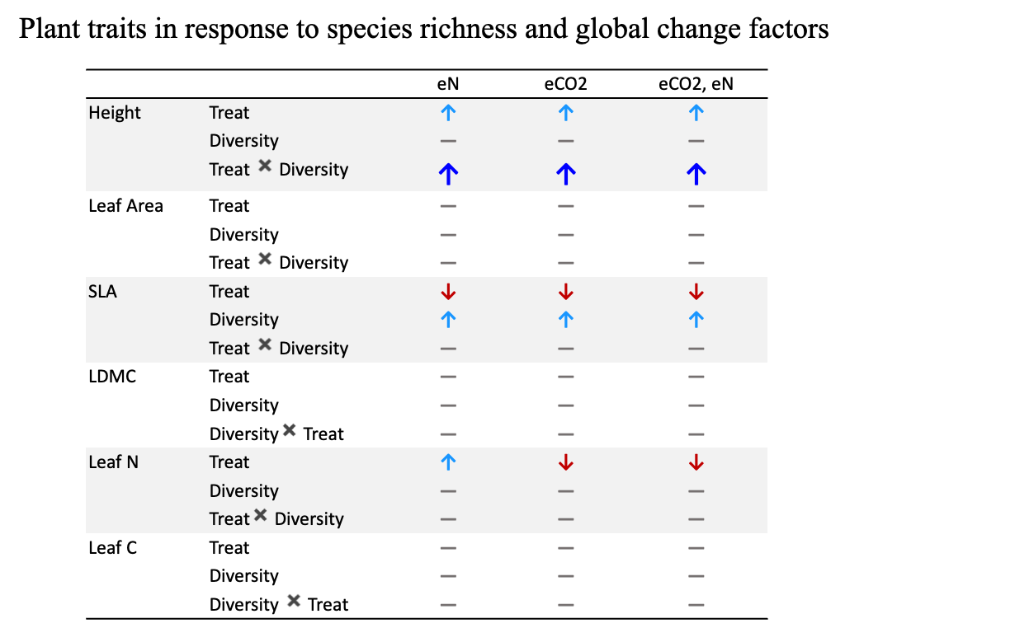
Plant functional trait responses to long-term elevated CO2 and nitrogen enrichment, and consequences on outcomes of species interactions
(Liting Zheng,
Peter Reich,
and others)
Datasets
Trait measurement was conducted from monocultures (n=128) to 16-species plots (n=48) in the BioCON experiment in 2023
two CO2 treatments (ambient, +180 ppm),
two soil N treatments (ambient, +4 g N m−2 ⋅y−1)
species richness gradient: 1, 4, 9, 16
Also covers TeRaCON dominant species
Objective 2:
How does trait variation within and among species eventually modulate species interactions?
Objective 1:
How do plant functional traits respond to elevated CO2, and soil nitrogen enrichment within and among species and whether the responses can be influenced by plant diversity?
Side project:
Sources of the functional trait variation under global change
[Using Bayesian ANOVA approach to asses how variable are functional traits at different scales/organization levels under global change]
Notes:
Liting Zheng
Summary:
Recent studies have assessed shifts in plant functional composition and diversity over time in response to elevated CO2 and N deposition. Plant functional traits have been shown to vary widely in response to elevated CO2 and N addition across and within species. In this study, using the data from an experiment BioCON, we aim to test how intra- and interspecific trait variability modulate functional trait space for accommodating plant diversity changes in plant communities under elevated CO2 and N addition.

Slide 19
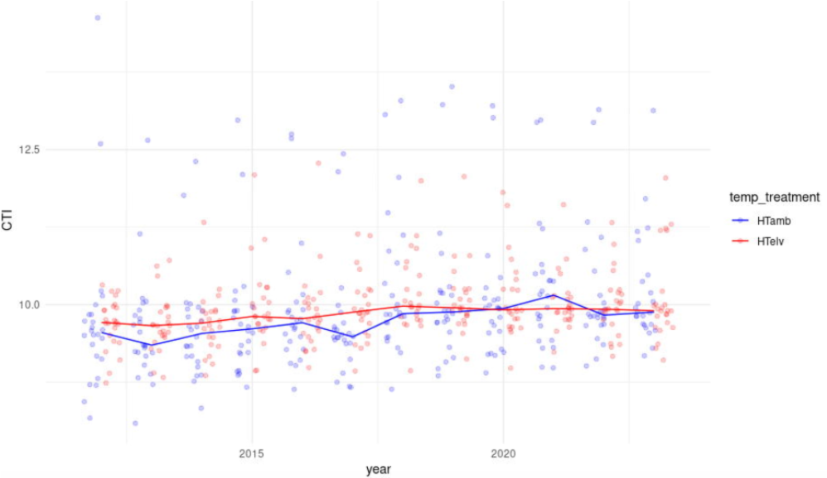
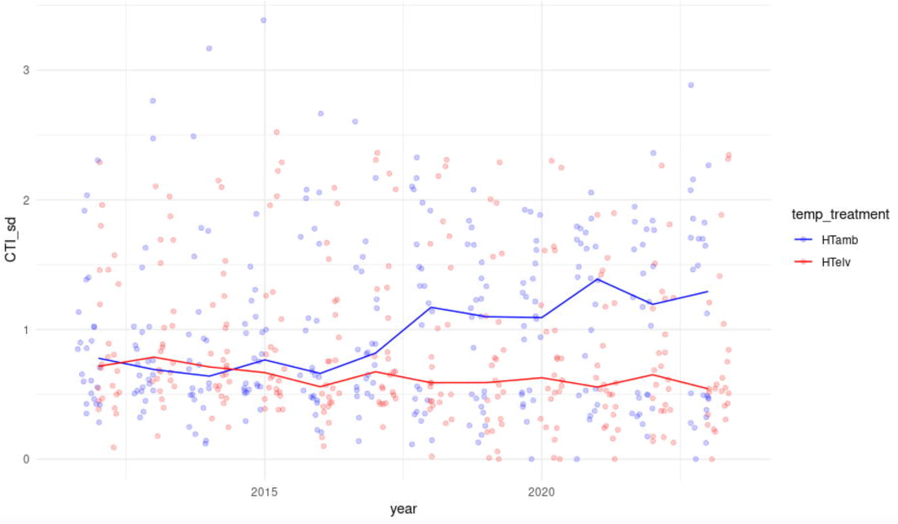
Kara: Ecological acclimation (super preliminary)

